Slide 1

Final Presentation
2
0
2
GAME
Semicolon

Slide 2
Names and roles
Hyunjun Lee
Dawoon Jung
Geumbi Yeo
Producer
Programmer
Programming
Assistant
Designer
Sound Director

Slide 3

Meaning of 2002

Slide 4


Meaning of 2002

Slide 5


Slide 6


Slide 7
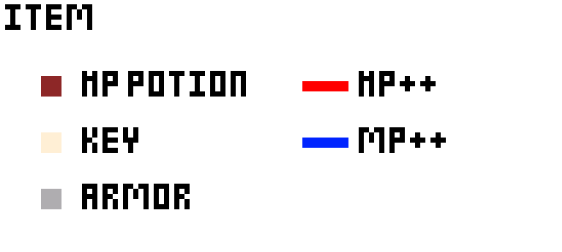

Slide 8



About 2002
if ( Player_MP < 50 ) 2.
{
}
HP MP

Slide 9



About 2002

Slide 10


About 2002
Player_HP < 100
HP

Slide 11

About 2002

Slide 12
